Slide 1
Veri Bilimi : Python ile Uygulamalı Doğal Dil İşleme
Monitoring NLP models in production
Interpretability of Models
Bias & Ethics in NLP
1 Haziran 2023

Slide 2
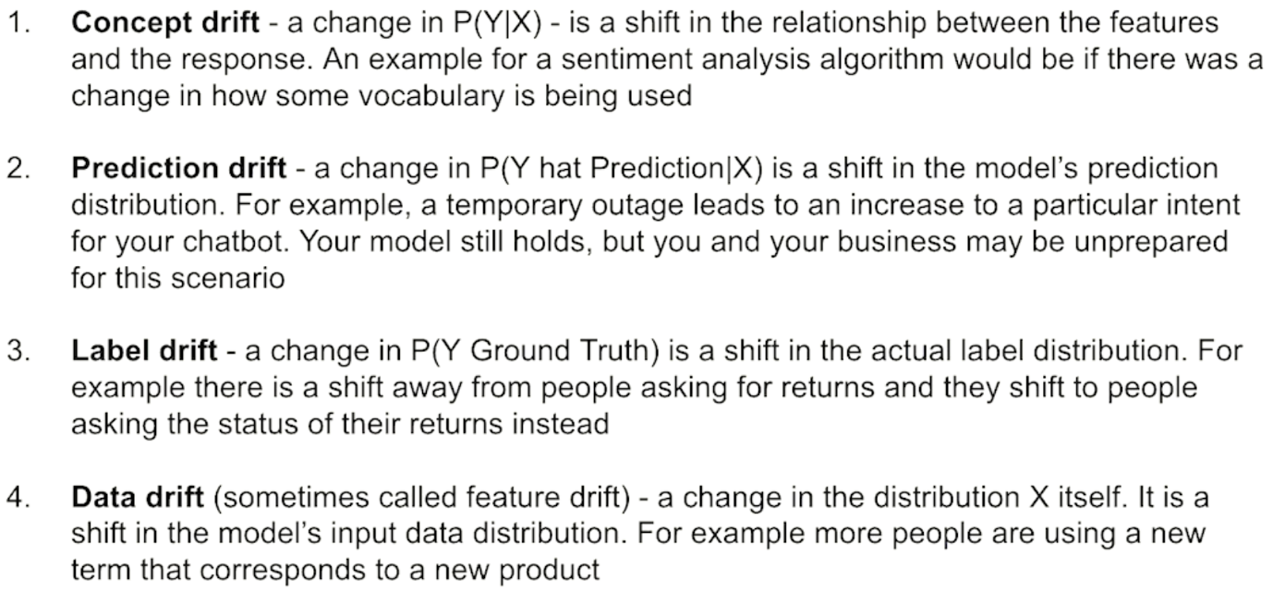
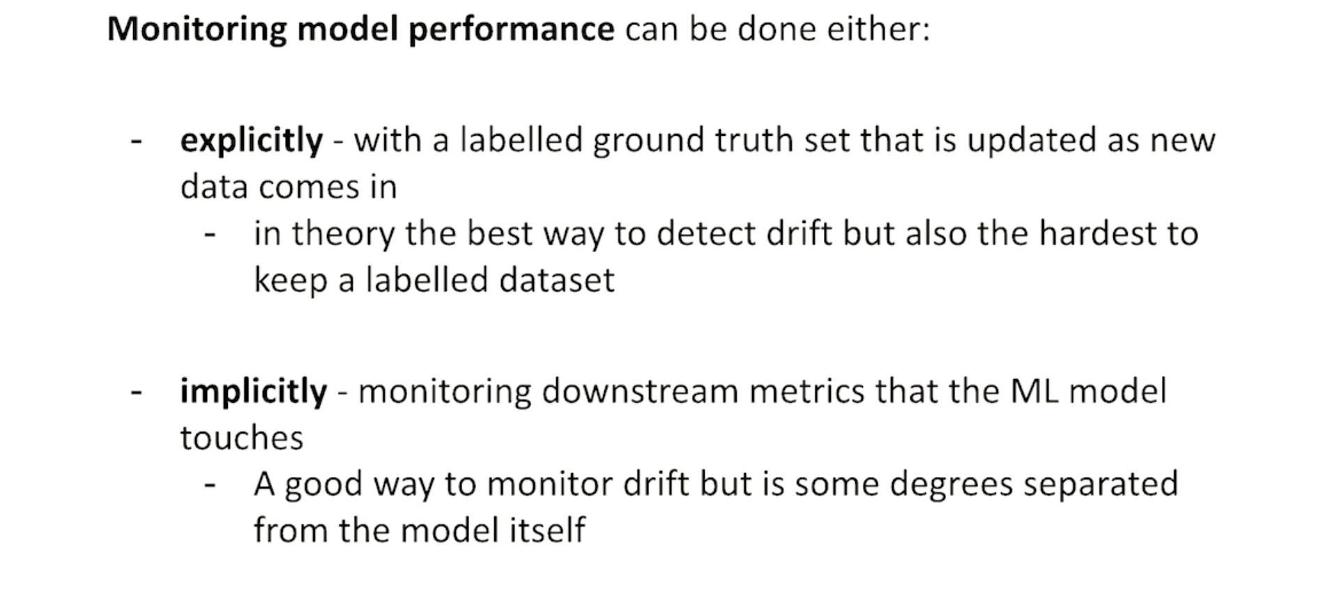
Detecting Drift
Slide credit:
Notes:
Exp -> birilerini arada test yapması. Modelle yemek yeme
Imp -> label disrtrituon ın değişimini monitor edebilirsin. Birşeylerin değiştini gösterir. Doalylı metriklerin takibi. Örneğin call cente aramalarını artması, başvuruların /uygun başvurların azalması

Slide 3
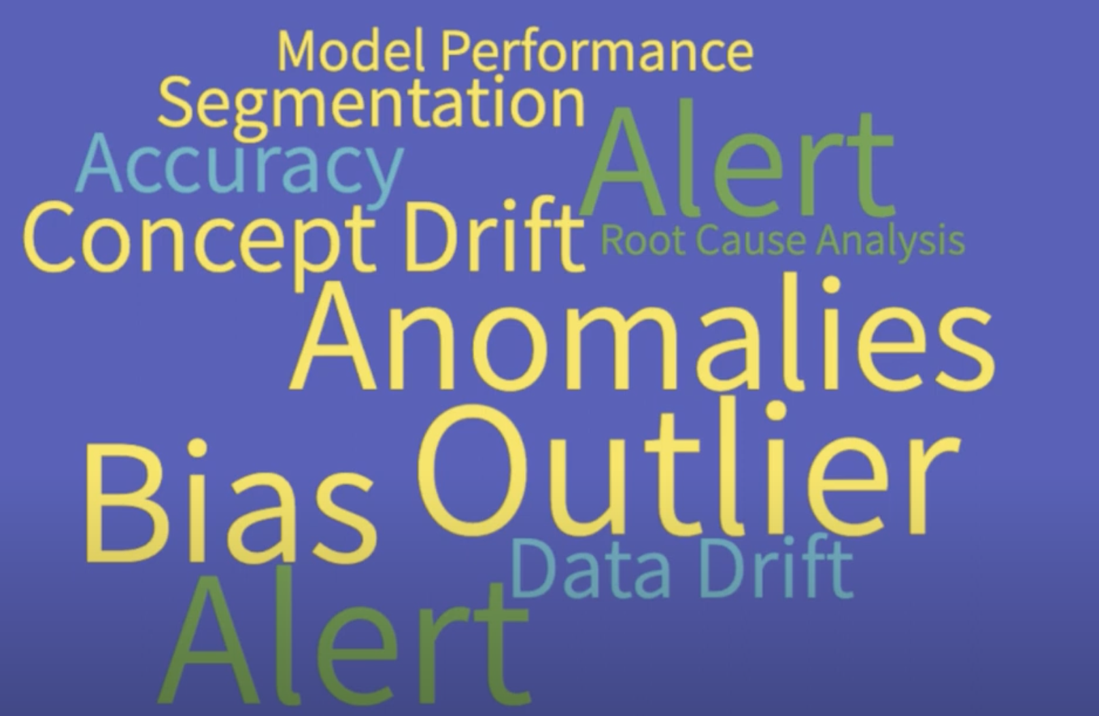
Monitoring NLP models in production
Slide credit:
Notes:
Why we need to monitor?

Slide 4
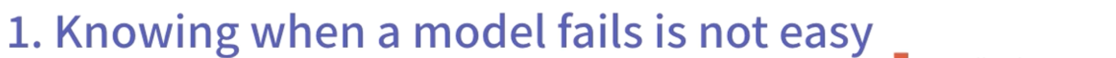
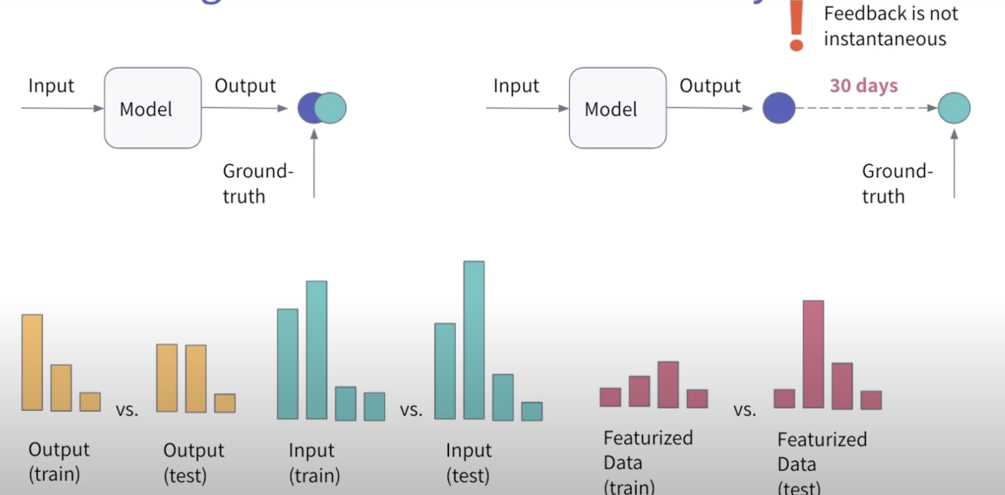
Monitoring NLP models in production
Why is it a hard problem?
Slide credit:
Notes:
Why we need to monitor?

Slide 5
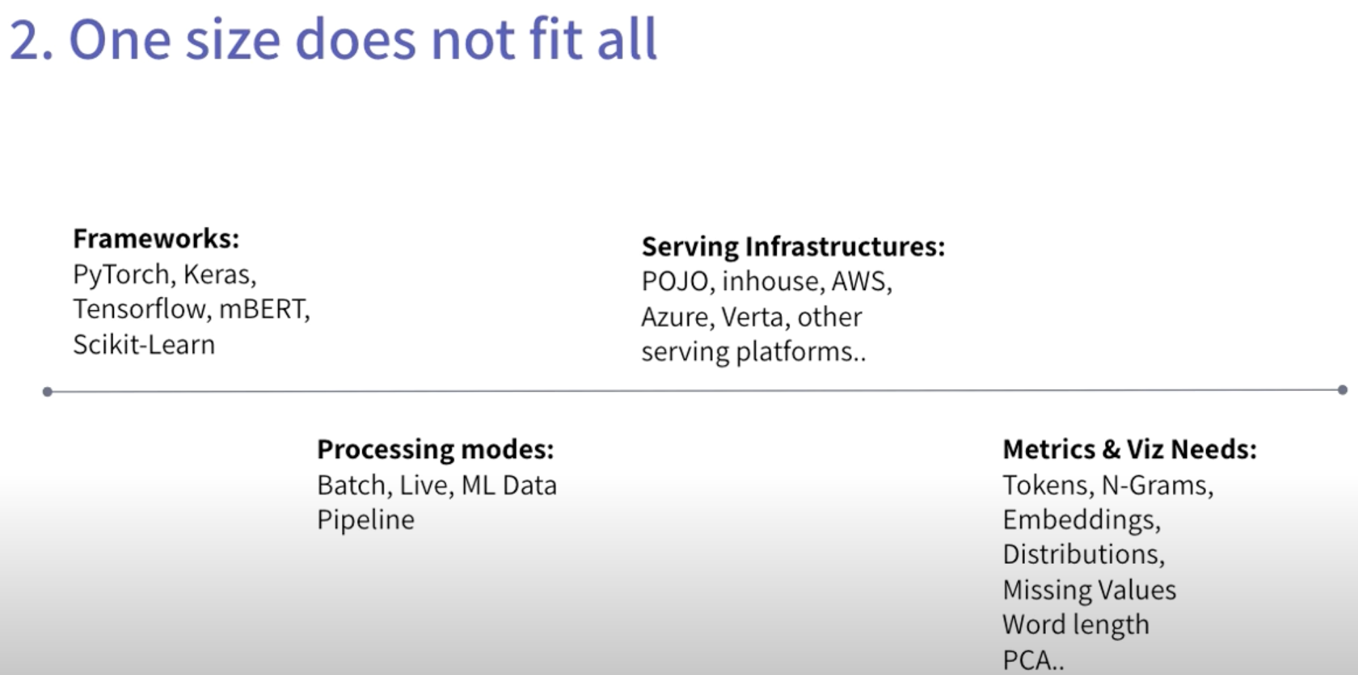
Monitoring NLP models in production
Why is it a hard problem?
Slide credit:
Notes:
Why we need to monitor?

Slide 6
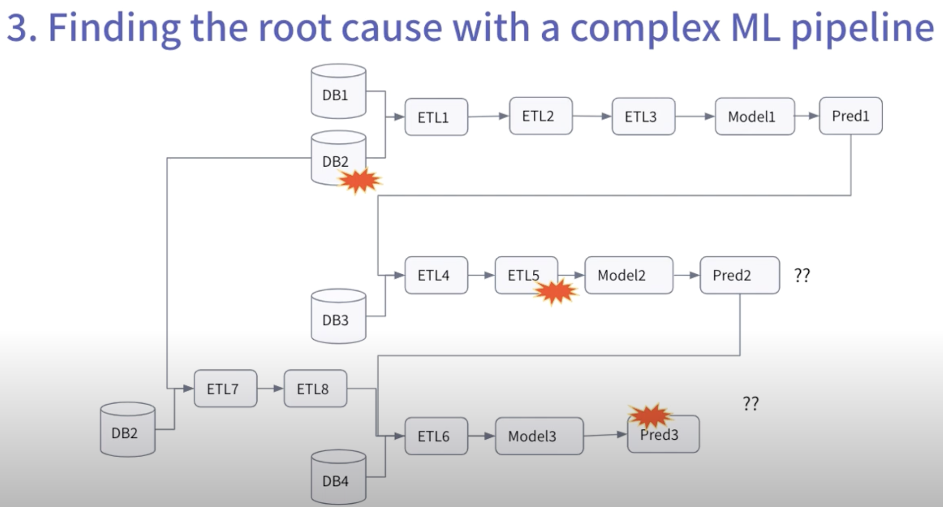
Monitoring NLP models in production
Why is it a hard problem?
Slide credit:
Notes:
Why we need to monitor?

Slide 7
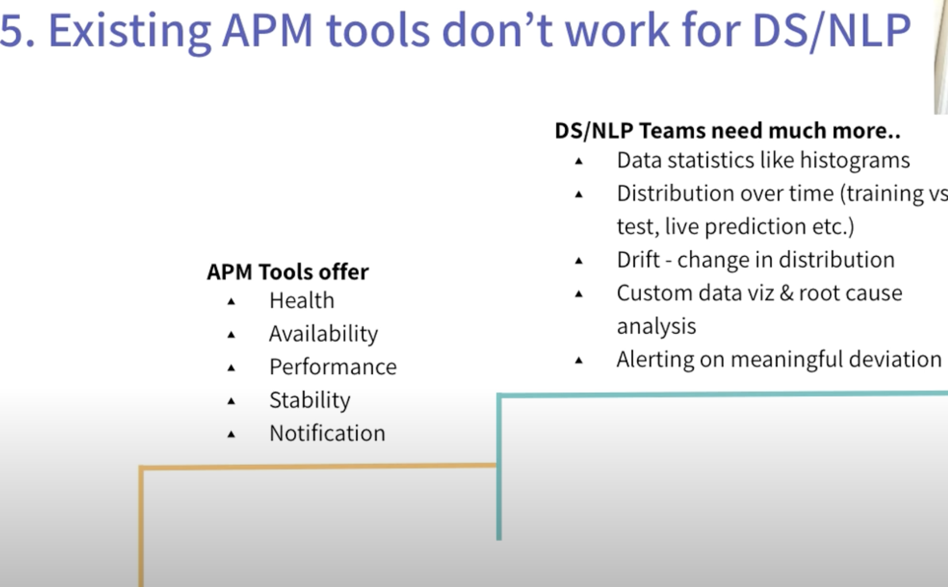
Monitoring NLP models in production
Why is it a hard problem?
NLP Models
Software
Slide credit:
Notes:
Why we need to monitor?

Slide 8
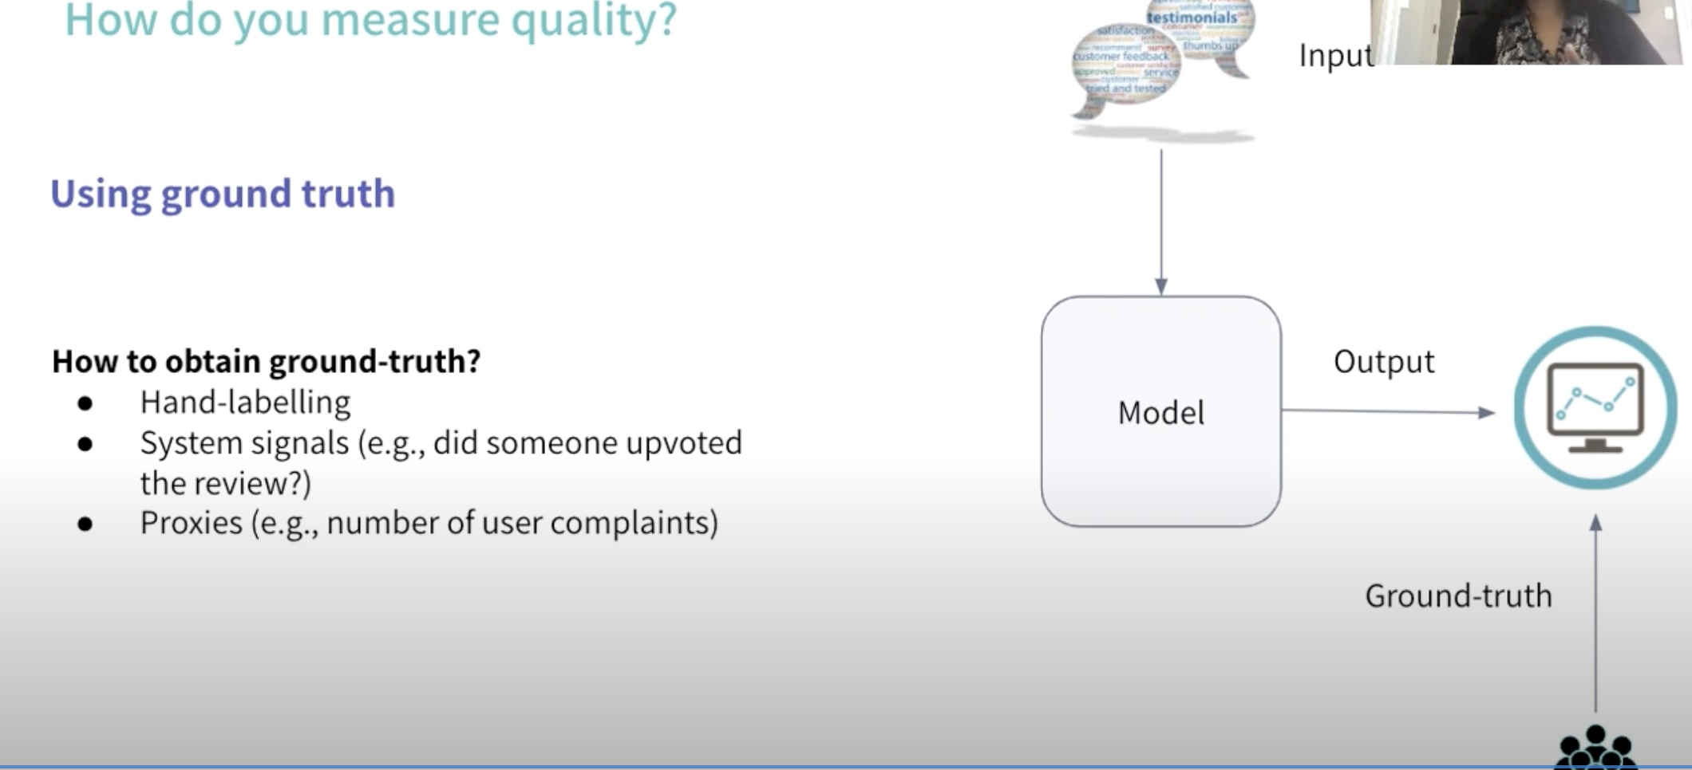
Monitoring NLP models in production
Know a model fails
Slide credit:
Notes:
Why we need to monitor?

Slide 9
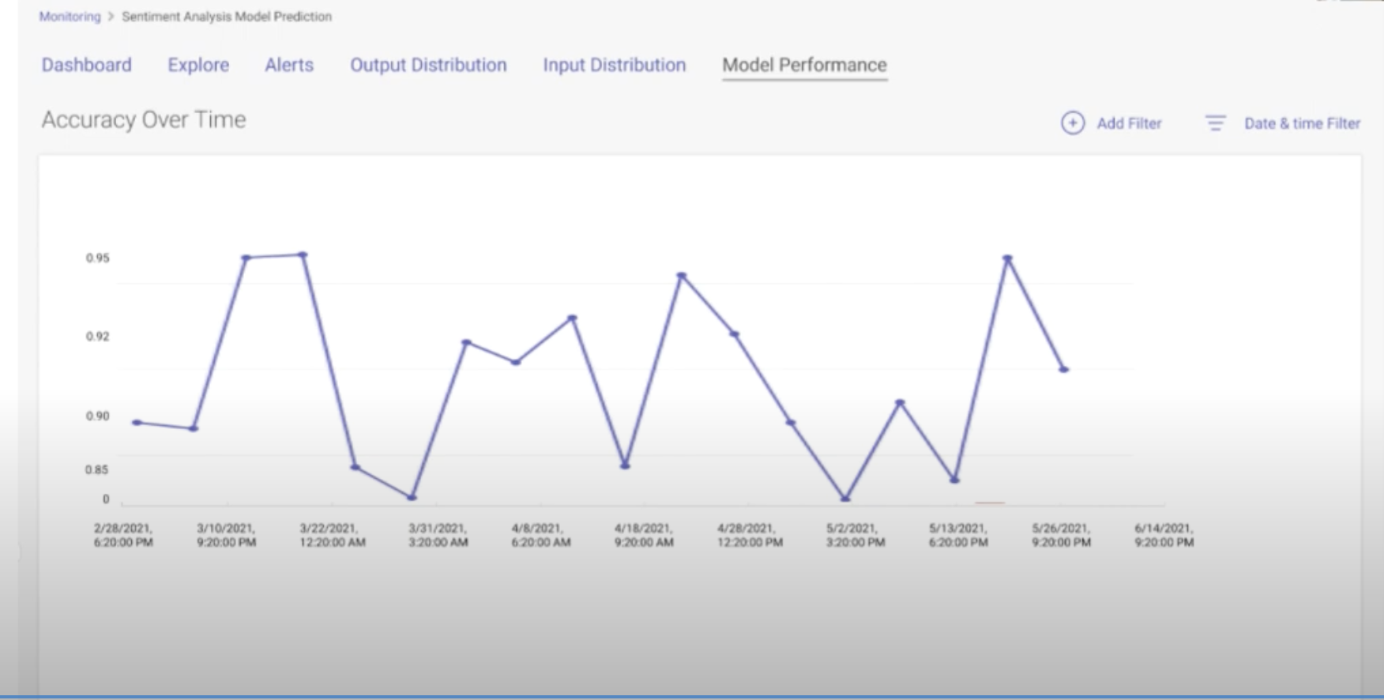
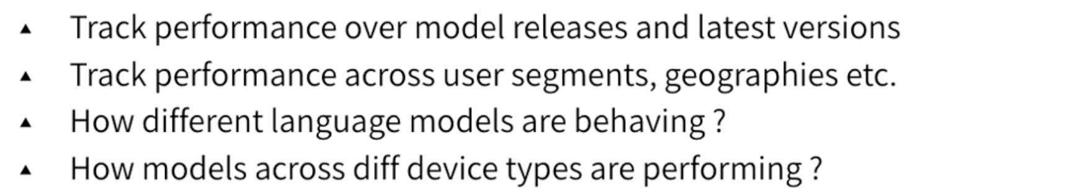
Monitoring NLP models in production
Track model performance over time
Slide credit:
Notes:
Why we need to monitor?

Slide 10
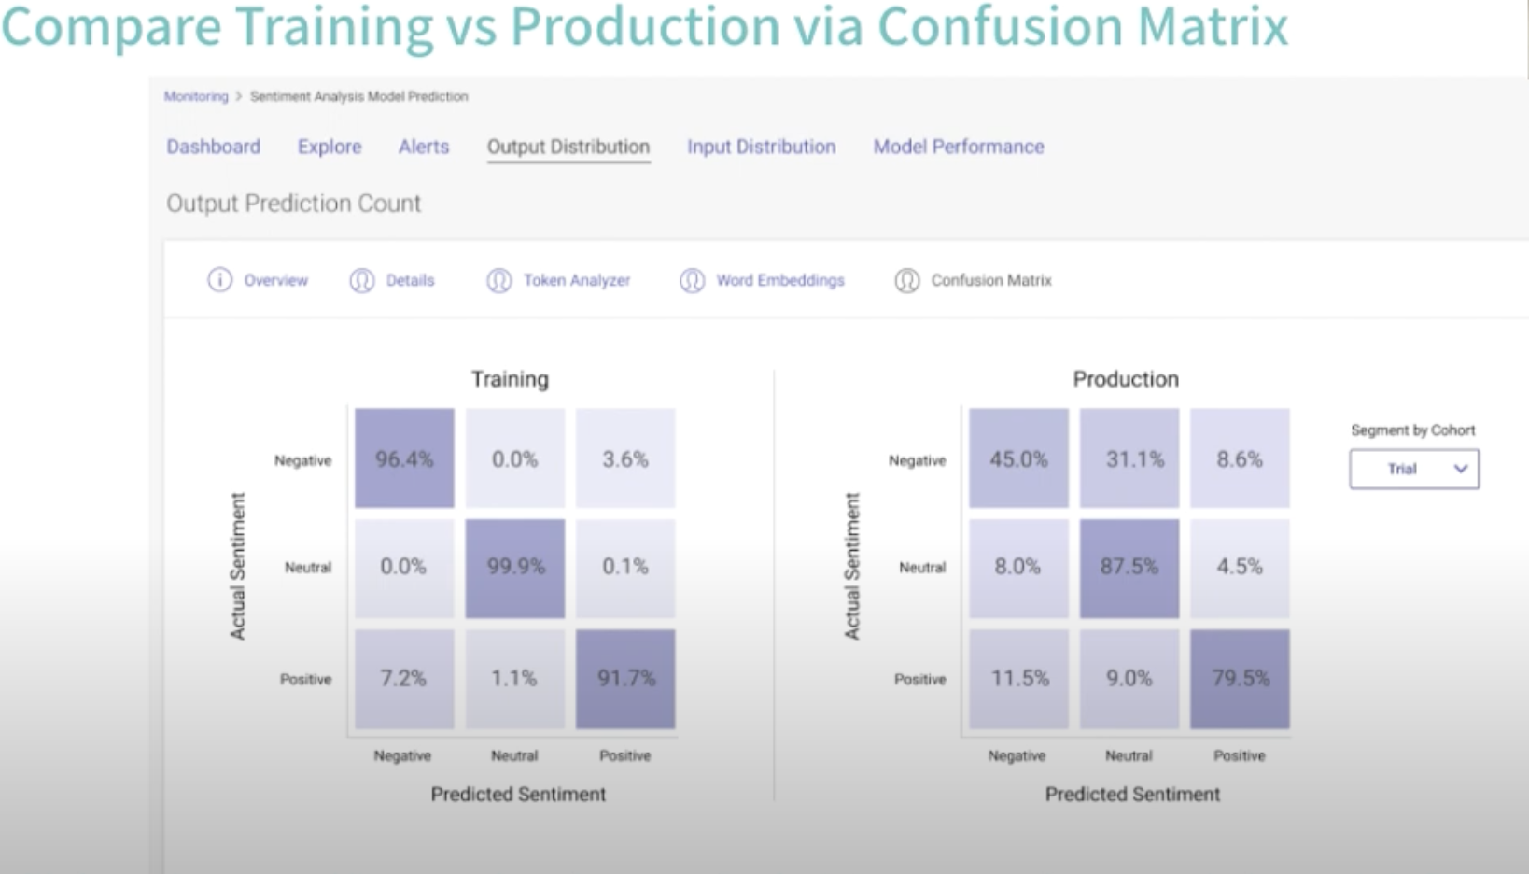
Monitoring NLP models in production
Compare Training & Production
Slide credit:
Notes:
Why we need to monitor?

Slide 11
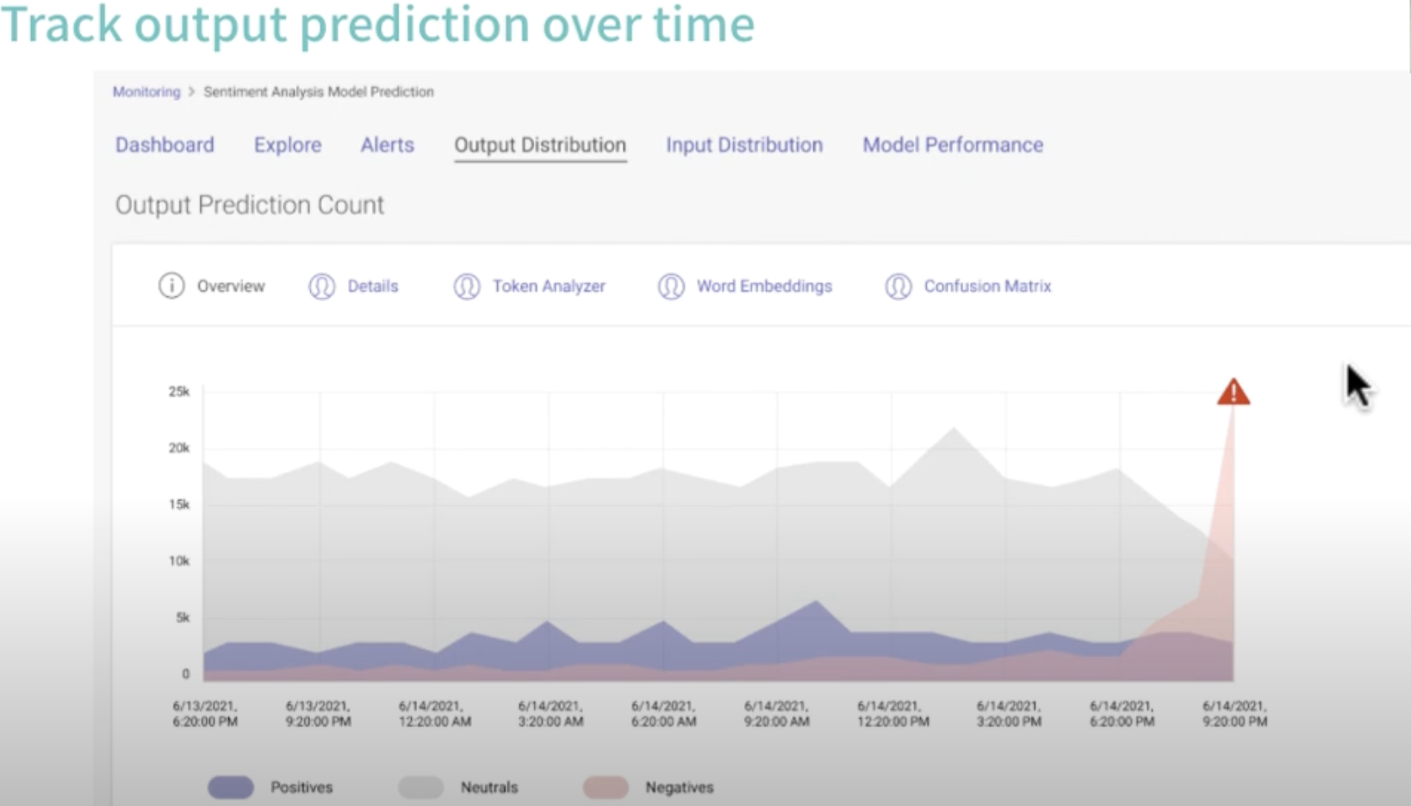
Monitoring NLP models in production
What if we can’t get feedback
Slide credit:
Notes:
Why we need to monitor?

Slide 12
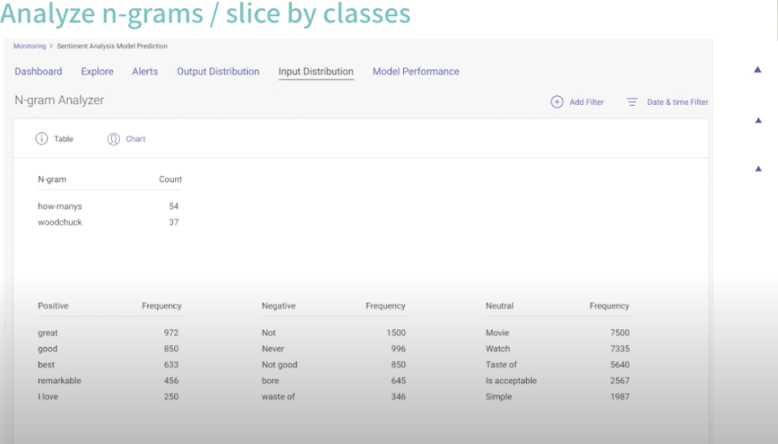
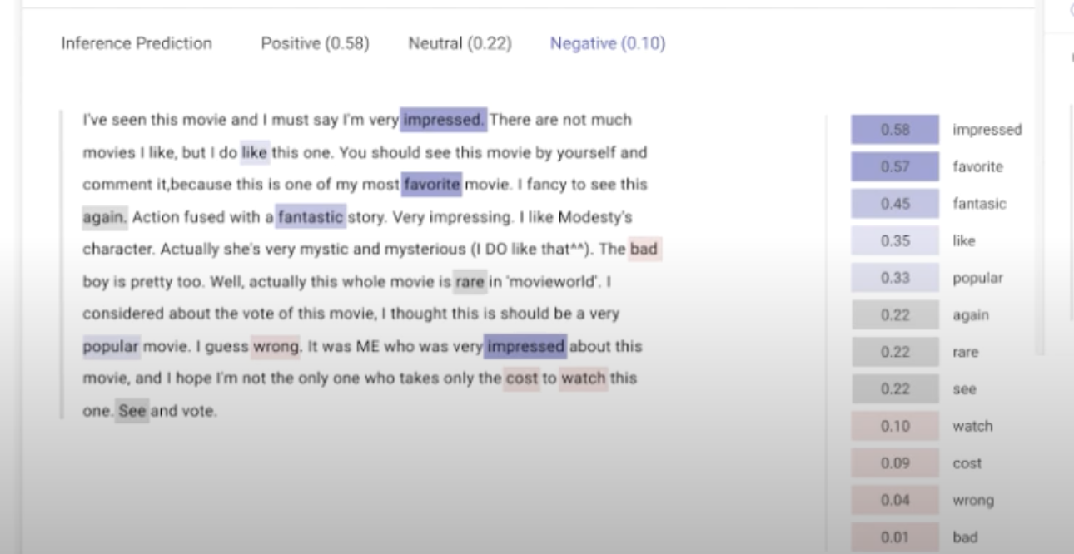
Monitoring NLP models in production
What if we can’t get feedback
Slide credit:

Slide 13
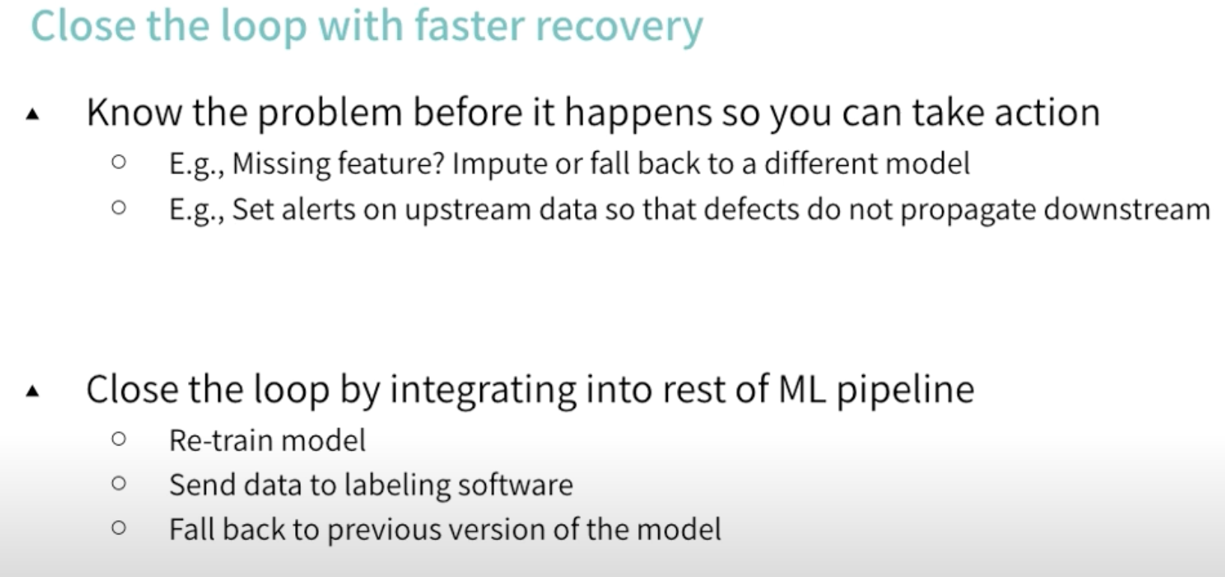
Monitoring NLP models in production
Remediate
Slide credit:

Slide 14
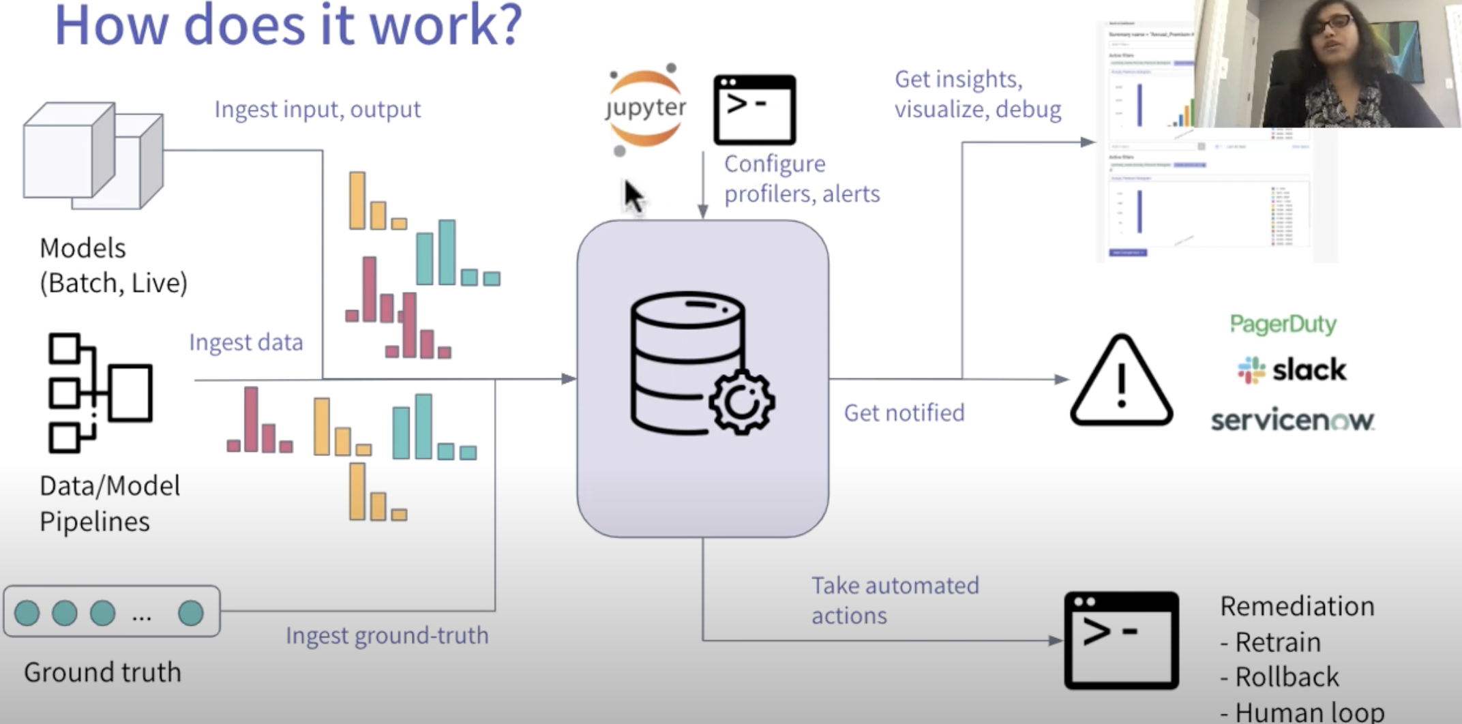
Monitoring NLP models in production
Slide credit:

Slide 15
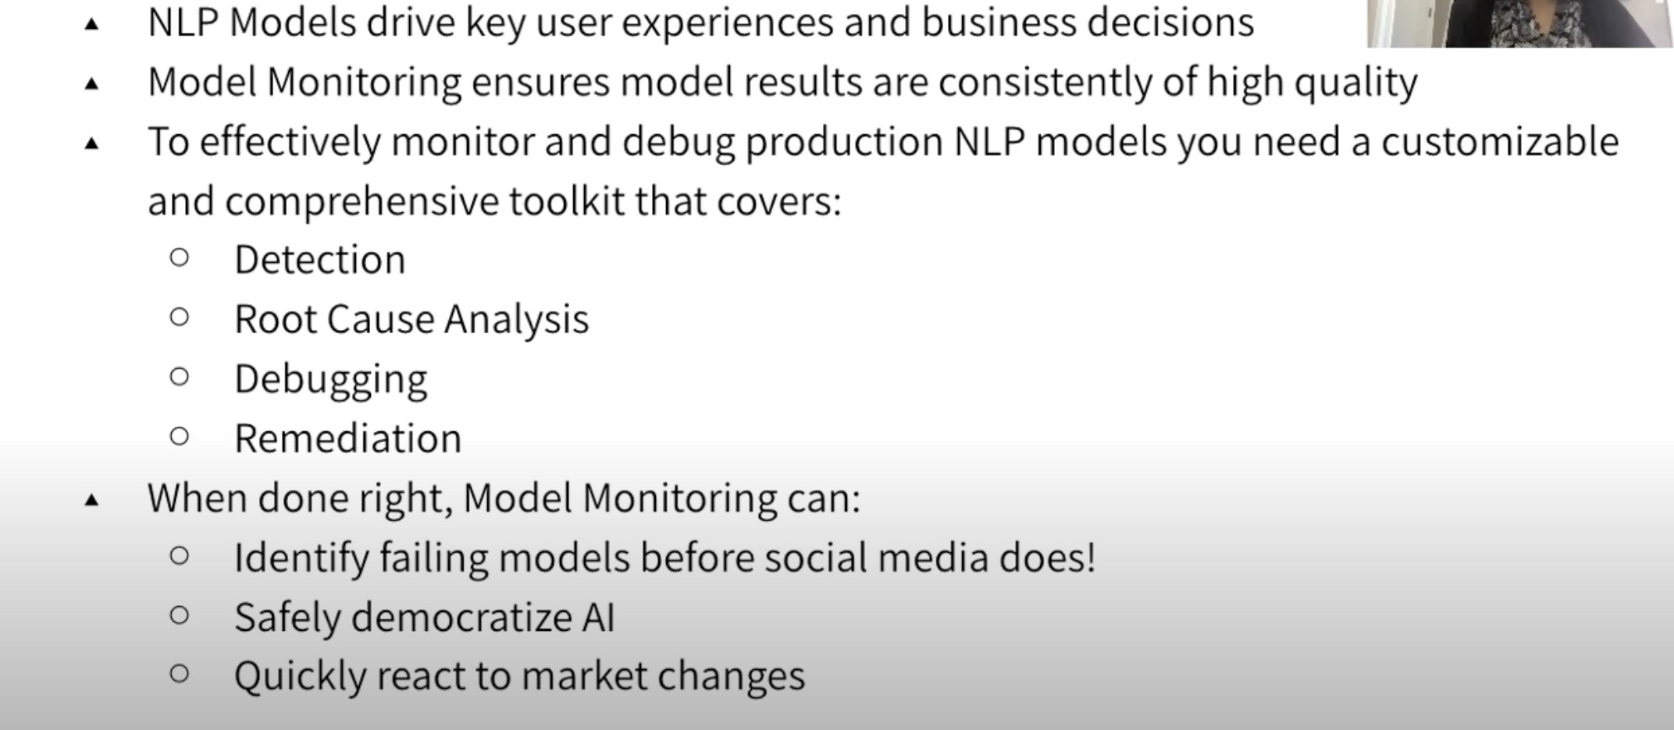
Monitoring NLP models in production
Summary
Slide credit: Meeta Dash, VP Product

Slide 16
Monitoring NLP models in production
https://colab.research.google.com/drive/15ON-Ub_1QUYkDbdLpyt-XyEx34MD28E1#scrollTo=OQYdNSdr__8j
http://192.168.19.65:5000/#/experiments/8
Slide credit:

Slide 17
Explanation vs Interpretation
Why should I trust you?
Model explanation and model interpretation are distinct concepts. The weights of a linear or logistic regression can be interpreted, whereas the weights of a complex neural network are not easily interpretable.
When we refer to explanation, we are talking about presenting textual or visual evidence that offers a qualitative understanding of how the components of an instance (such as words in text or patches in images) relate to the model's prediction.
For instance, if we are predicting the sentiment of a sentence like
"Amazing place to visit. Enjoyed the rides."
as positive,
the model should emphasize the words "Amazing" and "Enjoyed."
Slide credit:
Notes:
Interpretation->yorumlama

Slide 18
LIME
Data Sampling: LIME starts by creating perturbed versions of the input text by randomly adding or removing words. These perturbed samples are then fed into the NLP model.
Prediction Explanation: LIME uses the predictions made by the NLP model on the perturbed samples to learn a simpler, interpretable model, such as a linear or decision tree model. The interpretable model is trained to approximate the behavior of the NLP model in the local region around the instance of interest.
Feature Importance: LIME calculates the importance of each feature (i.e., word or token) based on the learned interpretable model. The importance is typically represented as a weight or score assigned to each feature, indicating its contribution to the prediction.
Explanation Visualization: The feature importance scores obtained from LIME can be visualized to provide a human-readable explanation. For example, the most important words or tokens can be highlighted or displayed along with their respective weights, indicating their impact on the model's prediction.
Slide credit:
Notes:
LIME, NLP modellerinin tahminlerini nasıl yaptığını açıklayan bir tekniktir. Girdi metnin hafifçe değiştirilmiş versiyonlarını oluşturur ve modelin tahminlerinin bu değişikliklere nasıl tepki verdiğini gözlemleyerek çalışır. Bu bilgilere dayanarak, belirli bir bölgede NLP modelinin davranışını yaklaşık olarak temsil eden daha basit bir model oluşturur. Bu basit model, modelin tahminleri için hangi kelimelerin veya özelliklerin önemli olduğunu belirlemeye yardımcı olarak, yorumlanabilir bir açıklama sağlar.

Slide 19
LIME
CODING TIME!!
Slide credit:

Slide 20
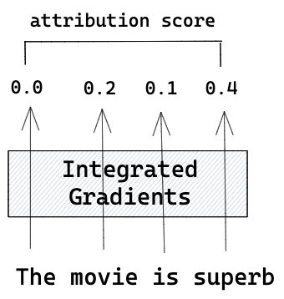
Integrated Gradients
Integrated Gradients allow examination of inputs' importance for the output in deep learning models.
Deep neural networks lack interpretability compared to linear regression models.
Linear regression allows accurate estimation of the impact of independent variables through weights.
Hidden layers in neural networks blur the input-output relationship due to the absence of direct links.
In large models with many neurons, it becomes impractical to trace the data path for interpretation.
Integrated Gradients provide a solution to understand model behavior and identify important features.
Slide credit:

Slide 21
Integrated Gradients
Start with a baseline: We choose a simple starting point, like a vector of zeros or the average of the input tokens' embeddings. (Baseline Token Representation)
Gradually change the tokens: We modify the input tokens step by step, moving from the baseline towards the original input representation. (Token Perturbation:)
Predict at each step: At each intermediate step, we feed the modified tokens into BERT and get predictions. These predictions could be probabilities for different classes. (Model Prediction)
Measure token importance: We calculate the importance of each token by looking at how much the predictions change as we modify the tokens. We consider how sensitive the model's output is to changes in the token representation. (Attribution Calculation)
Combine token importance: We add up or average the importance scores of each token to get an overall measure of importance for the input sequence. (Aggregation)
By following these steps, Integrated Gradients helps us understand which tokens are most important for BERT's predictions. It provides insights into why BERT makes certain predictions and helps us analyze and interpret its results.
Slide credit:
Notes:
Token'ları yavaşça değiştirin: Baseline'a doğru ilerleyerek girdi token'larını adım adım değiştiririz.
Her adımda tahmin yapın: Her ara adımda, değiştirilmiş token'ları BERT'e vererek tahminler alırız. Bu tahminler, farklı sınıflar için olasılıklar olabilir.
Token önemini ölçün: Token'ların önemini hesaplamak için, token'ları değiştirirken tahminlerin ne kadar değiştiğine bakarız. Modelin çıktısının token temsilindeki değişikliklere ne kadar hassas olduğunu düşünürüz.
Token önemini birleştirin: Her token'ın önem puanlarını toplar veya ortalarız, böylece giriş dizisi için genel bir önem ölçüsü elde ederiz.

Slide 22
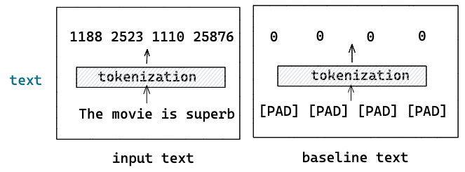
Integrated Gradients
CODING TIME!!
Slide credit: https://towardsdatascience.com/interpreting-the-prediction-of-bert-model-for-text-classification-5ab09f8ef074

Slide 23
Integrated Gradients
The Integrated Gradients method is a way to make a classification model interpretable.
It can be used for all models that are differentiable, i.e. derivable. This includes, for example, neural networks, but not the basic machine learning models, such as Random Forest or Linear Regression.
Applications of the Integrated Gradient method include, for example, finding out the feature importance, debugging models, as well as improving the data set with respect to the important features.
A baseline is defined that has no effect on the classification result. Then, in a few steps, interpolations are given to the model, and the gradient is used to determine what influence the individual inputs have on the result.
Slide credit:

Slide 24
Using Explanations in Practice
Appropriate use of explanations:
Mid data-science workflow
Error analysis for surprising false-positives or false-negatives
Challenges in showing explanations to end users:
Nuance in interpreting explanations
Setting appropriate expectations
Training and clear user experience required
Caution in using explanations in automated capacity:
Avoid automated workflows based solely on explanations
Use explanations to flag items for manual review
Compute requirements for obtaining explanations:
Fitting a few thousand small models per explanation
Takes 20-30 seconds on a 2020 laptop
Not prohibitive for single data points
Prohibitive in production environments with large datasets
Compromise for compute requirements:
End users can request explanations for specific decisions
Case-by-case basis for explanations
User experience can manage a 30-second wait
Slide credit: https://brainsteam.co.uk/2022/03/14/painless-explainability-for-text-models-with-eli5/#using-explanations-in-practice

Slide 25
Five sources of bias in NLP
The Data:
Example: Gender Bias in Language Models
Language models trained on biased text data may exhibit gender bias in their output, reinforcing stereotypes or reflecting societal biases present in the training data.
The Annotation Process:
Example: Racial Bias in Sentiment Analysis
Biased annotations by human annotators can introduce racial bias in sentiment analysis systems, leading to skewed interpretations of text sentiment based on the racial or ethnic identity of the author.
The Input Representations:
Example: Bias in Named Entity Recognition (NER)
Biased representations in NER can lead to underrepresentation or misclassification of certain names or entities, such as ethnic or culturally diverse names, due to limitations in the training data or biased algorithms.
The Models:
Example: Socioeconomic Bias in Automated Resume Screening
Models trained to screen resumes for job applications may exhibit bias against candidates from lower socioeconomic backgrounds, as certain features or patterns associated with disadvantaged groups may be inadvertently penalized or overlooked.
The Research Design:
Example: Confirmation Bias in Sentiment Analysis Studies
Research studies on sentiment analysis that focus only on specific domains or user demographics may introduce confirmation bias, providing a limited perspective and failing to capture the full range of opinions and sentiments expressed across diverse populations.
Notes:
1- Selection bias (minority groups
2- In its simplest form, bias arises because annotators are distracted, uninterested, or lazy about the annotation task. As a result, they choose the ‘wrong’ labels – birden fazla kişinin aynı şeyi etiketlemesi..
3-), gender biases in the training data
https://www.mzes.uni-mannheim.de/socialsciencedatalab/article/bert-explainable-ai/
Language models trained on biased text data may exhibit gender bias in their output, reinforcing stereotypes or reflecting societal biases present in the training data. İnsan etiketleyiciler tarafından yapılan önyargılı etiketlemeler,
duygu analizi sistemlerinde ırksal önyargıya neden olabilir. Bu durum, metin duygusunun yorumunda yazarın ırksal veya etnik kimliğine dayalı olarak eğik yorumlamalara yol açabilir.
Örnek: İsim Varlık Tanıma (NER) Önyargısıİsim varlık tanıma sistemlerindeki önyargılı temsiller, eğitim verilerindeki sınırlamalar veya önyargılı algoritmalar nedeniyle etnik veya kültürel açıdan çeşitli isimlerin veya varlıkların eksik veya yanlış sınıflandırılmasına yol açabilir.
Örnek: Otomatik Özgeçmiş Değerlendirmede Sosyoekonomik Önyargıİş başvurularını değerlendirmek için eğitilen modeller, düşük sosyoekonomik geçmişi olan adaylara karşı önyargı sergileyebilir. Dezavantajlı gruplarla ilişkilendirilen bazı özellikler veya desenler yanlışlıkla cezalandırılabilir veya gözden kaçırılabilir.
Yalnızca belirli alanlara veya kullanıcı demografiklerine odaklanan duygu analizi üzerine yapılan araştırma çalışmaları, onaylama önyargısını dahil edebilir. Bu durum, sınırlı bir perspektif sunar ve çeşitli toplumlar arasında ifade edilen farklı görüş ve duyguların tam yelpazesini yakalamada başarısız olabilir.

Slide 26
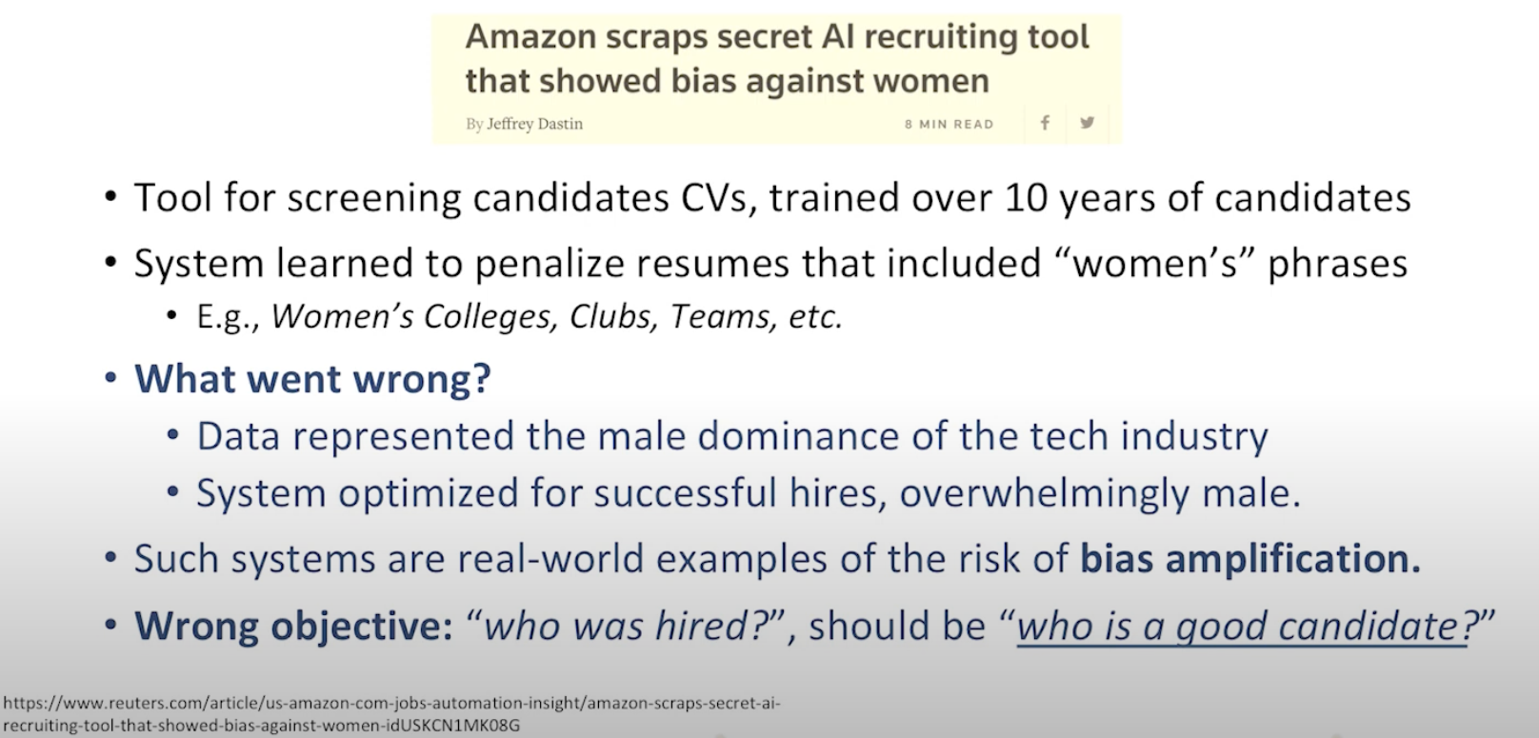
Social Bias
Thank You!
Slide credit:

Slide 27
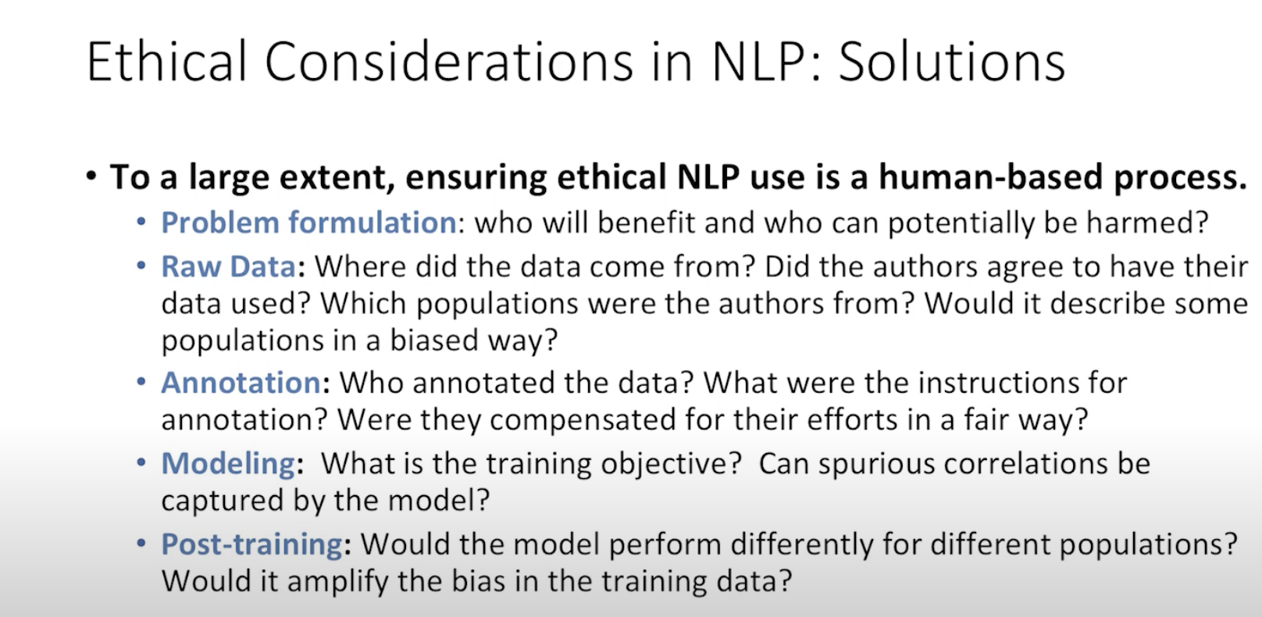
Ethical Considerations in NLP : Solutions
Thank You!
Slide credit:

Slide 28
The End
Thank You!
Slide credit:

Slide 29
First : A small experiment left from the previous lesson.
Combining Categorical Features with Text in BERT
https://colab.research.google.com/drive/1YRHK4HO8RktGzlYmGjBo056kzVD4_j9o#scrollTo=BJR6t_gCQe_x
Slide credit:

Slide 30
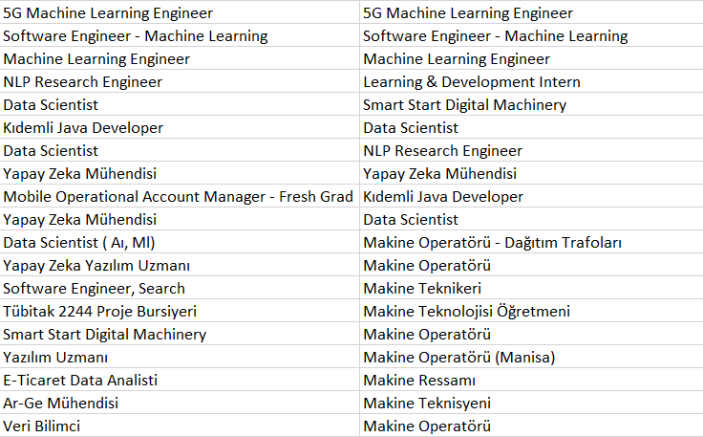
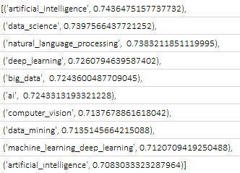
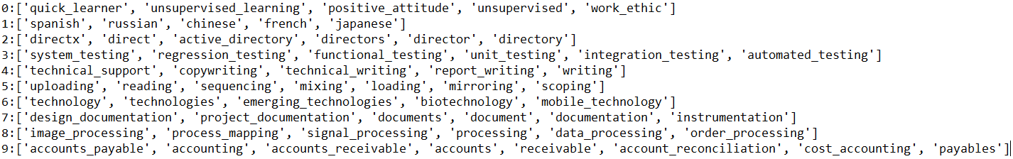
Kelime Vektör Algoritmaları Tabanlı Kümeler ile Arama Sonuçları Uygunluğu Geliştirme
1
Kelime vektörlerinin oluşturulması – 770k ilan dökümanı için. Örnek, «machine learning» yakınlıkları
3
Machine learning araması için ilan sonuçları. Sağ taraf yeni model, sol güncel sonuçlar
2
Vektörlerin kümelenmesi
4
İlk 10 sonuç uygun/değil olarak ortalama başarısı
 | Current Query Results | Improved Query Results
Bilgi İşlem | 0.975 | 1
İnşaat Mühendisi | 0.925 | 0.975
İç Mimar | 0.872 | 0.925
Laboratuvar | 0.75 | 0.925
Çevre Mühendisi | 0.75 | 0.818
Makam Şoförü | 0.6 | 0.925
Mechanical Engineer | 0.375 | 0.925
Tekstil Mühendisi | 0.575 | 0.657
Veri Bilimi | 0.225 | 0.666
Türk Hava Yolları | 0.125 | 0.75

